Slide 1
UBER DATA ANALYSIS
Team members:
DASARI SHIVA-20BCE7075
DASARI SRIKANTH-20BCE7076

Slide 2
Abstract
Data analytics has helped many companies to optimize and grow their performance for the decades. Data analytics and visualization has aided us with several benefits, few of them being identifying emerging trends, studying relationships and patterns in data, analysis in depth. This project is all about understanding one such data set of uber from New York City and is very component to understand the use of data analytics and visualization. It is generated with the help of ‘R’ programming language using libraries and packages such as ggplot2, lubridate, dplyr and tidyr. Through projects like this, we can gain knowledge of various complex operations performed in data visualization. It will enable us to recognize the patterns in data of this huge organization and provides critical insights of untapped information. Also guide us in understanding the operations of different R libraries.
Keywords: Uber, Data analytics, Data visualization, R programming, ggplot, lubridate, dplyr, tidyr, DT, scales.

Slide 3
Packages
Ggplot2 : This is the backbone of this project. ggplot2 is the most popular data visualization library that is most widely used for creating aesthetic visualization plots.
Ggthemes: This is more of an add-on to our main ggplot2 library. With this, we can create better create extra themes and scales with the mainstream ggplot2 package.
Dplyr :This package is the lingua franca of data manipulation in R.
tidyr :This package will help you to tidy your data. The basic principle of tidyr is to tidy the columns where each variable is present in a column, each observation is represented by a row and each value depicts a cell.
DT :With the help of this package, we will be able to interface with the JavaScript Library called – Data tables.
Scales
With the help of graphical scales, we can automatically map the data to the correct scales with well-placed axes and legends.

Slide 4

Problem Statement
Uber is an application-based transportation organization and taxi organization. In its many rides in a specific city, large numbers of its users face the problem of cancellation by the driver or non-availability of cars.
These issues influence the matter of Uber and it misses out on its income.

Slide 5
Introduction
To grow business with this competitive environment data analysis is necessary. Data analysis reports, and other kinds of analysis and report documents must be developed by businesses so that they can have references for peculiar activities and undertakings especially when making decisions for the future operations of the company. The Excel files with the weather data and Uber pick-up data should be joined together for the analysis. A data analysis can be developed accordingly if you can arrange all the information based on the activity that you will undergo.
In the modern world, Uber has emerged as the leading organization for setting up new transportation options. People use analytics in their businesses to help it grow, and this market is one that is rapidly expanding. This project will improve our understanding of how to use the ggplot2 library to comprehend the data and to acquire an intuition for comprehending the consumers who benefit from the travels.

Slide 6
The only transportation service to analyse and communicate actual sustainability statistics is Uber. Our goal in this R project is to analyse the dataset for Uber pickups in New York City. This project focuses primarily on data visualisation and will teach us how to use the ggplot2 library to understand the data and develop an accurate understanding of the travellers.
Uber analyses historical data for, say, the past three or four weeks and finds areas of the city where demand is particularly strong.

Slide 7
Objectives
Our main objectives of this project are:
• Visualize the growth of Uber in NYC;
• Analyze the demand based on trends in the time series;
• and calculate the market size for Uber in NYC.
• Additional information on how the service is used;
• An effort to estimate the rise in demand.

Slide 8
Description of dataset
The dataset includes data on Uber pickups in New York City between April 2014 and September 2014.
There are more than 500k pickups (rows) with the following 4 columns:
Date/Time - The time and date of Pickup
Latitude of pickup
Longitude of pickup
base

Slide 9
Methodology
Initial Analysis:
Understand the dataset given. Look through its structure, identify the datatypes of various columns and get a basic idea of the dataset to proceed further.
Data Cleaning:
Look out for visible data quality issues and rectify them. Check for blanks, duplicate data and convert certain columns to required datatypes.
Exploratory Data Analysis:
Making use of R, carry out various EDA operations like Univariate and Segmented Univariate analysis and come up with intuitive insights of the Supply-Demand problem.
Visualization:
Make use of R libraries & package to plot various graphs with proper aesthetics and geometry, clearly displaying important insights.

Slide 10
Proposed System:
We proposed that we will build a data visualization project with ggplot2 using R and its libraries. Analyse various parameters like
(a) Trips by the hours in a day’
(b) Trips during months in a year.
At the end create visualizations for different timeframes of the year. Explain how time affects customer trips.
• Find the days on which each basement has a greater number of active vehicles.
• Can tap growing markets in suburban areas where taxi services are not available.
• The estimated time of arrival can be shortened with an increase in Uber drivers, which would gradually raise customer satisfaction and increase both the company's income and drivers' profits. The most popular travel destinations, as determined by the number of booked trips, will be identified based on the data.

Slide 11
Analysis
Creating vector of colors to be implemented in our plots
we will create a vector of our colors that are in our plotting functions. You can also select your own colors that you want.
Reading the Data into their designated variables
we will read the several csv files that contain the data from April 2014 to September 2014. We will store these in corresponding data frames like apr_data, may_data, etc. After we have read the files, we will combine all of this data into a single data frame called ‘data_2014’.

Slide 12
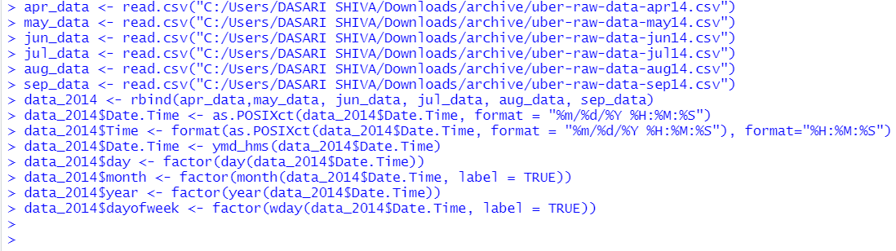
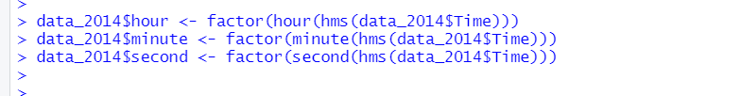
Reading csv files

Slide 13
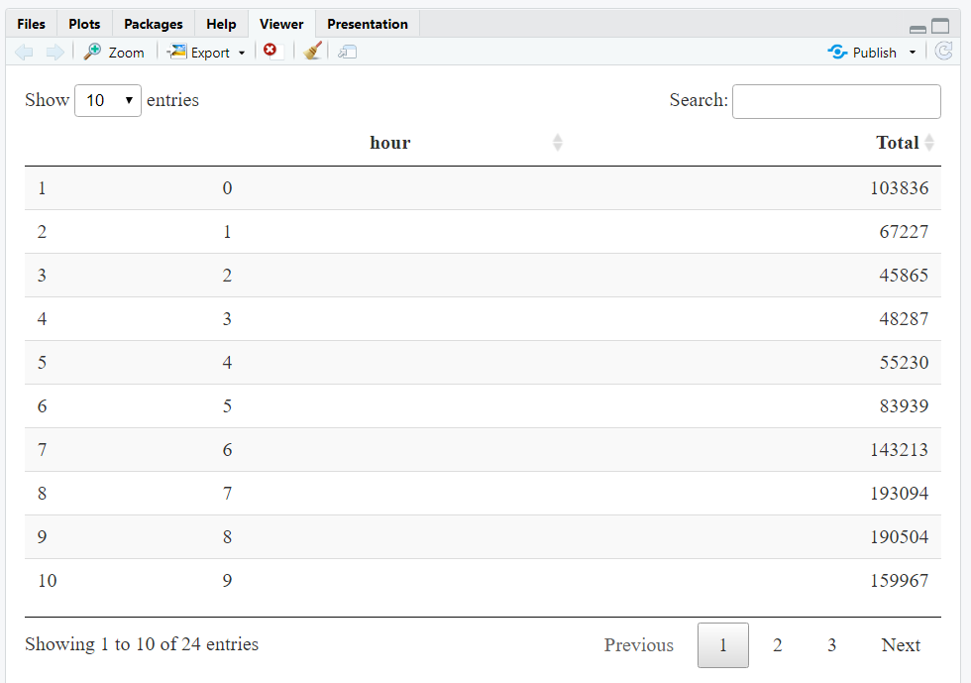
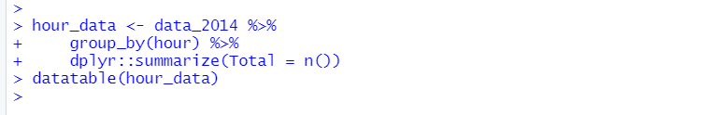
Plotting the trips by hours in a day
Here we will be using the ggplot function to plot the number of trips that the passengers had made in a day. We will also use dplyr to aggregate our data. In the resulting visualizations, we can understand how the number of passengers fares throughout the day. We observe that the number of trips are higher in the evening around 5:00 and 6:00 PM.

Slide 14
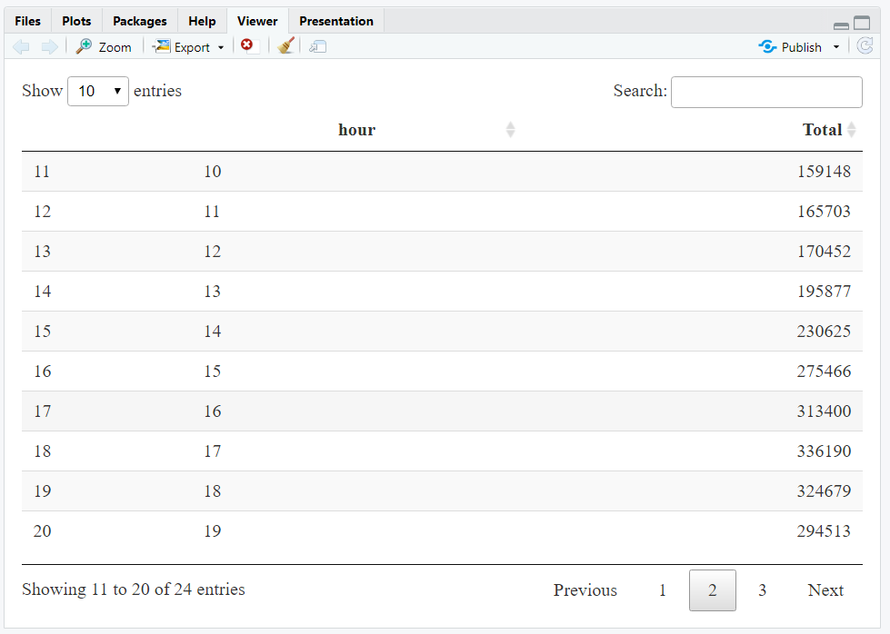
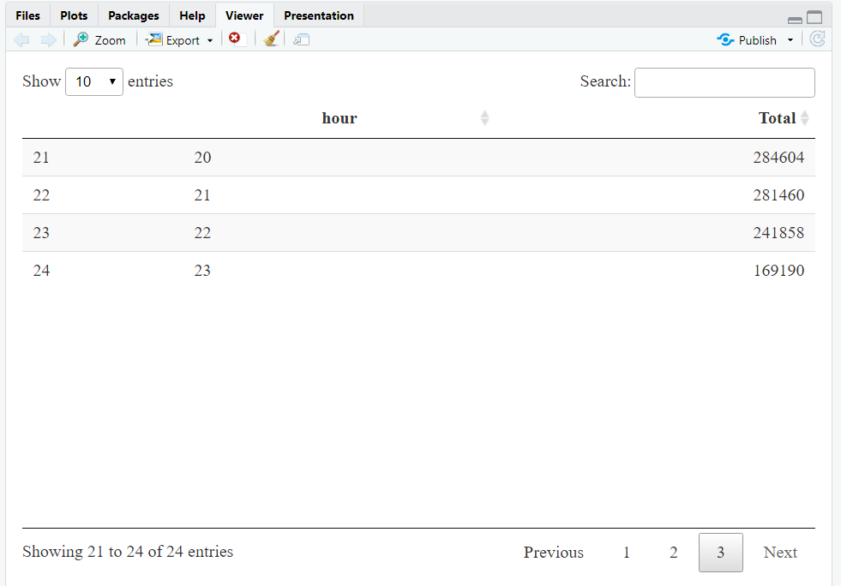

Slide 15
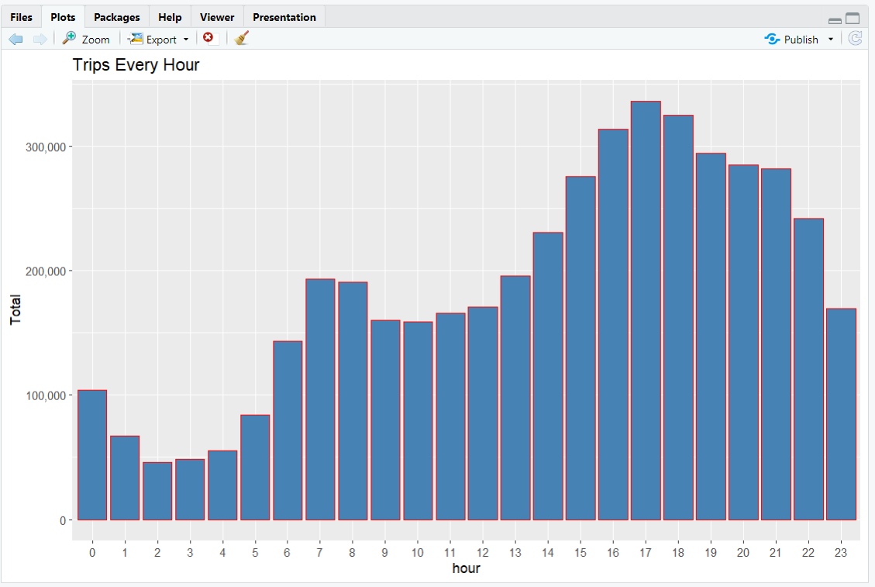
Trips by Every hour:

Slide 16
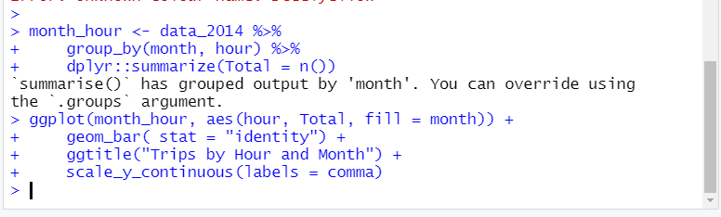
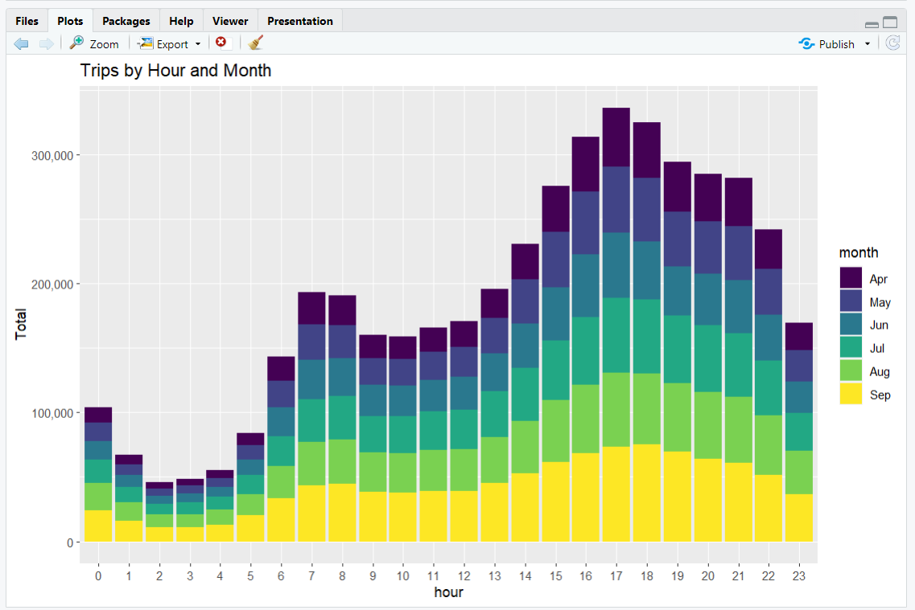
Trips by Every hour and month

Slide 17
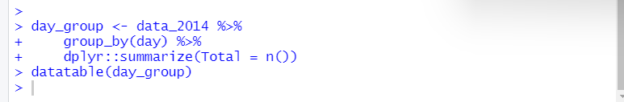
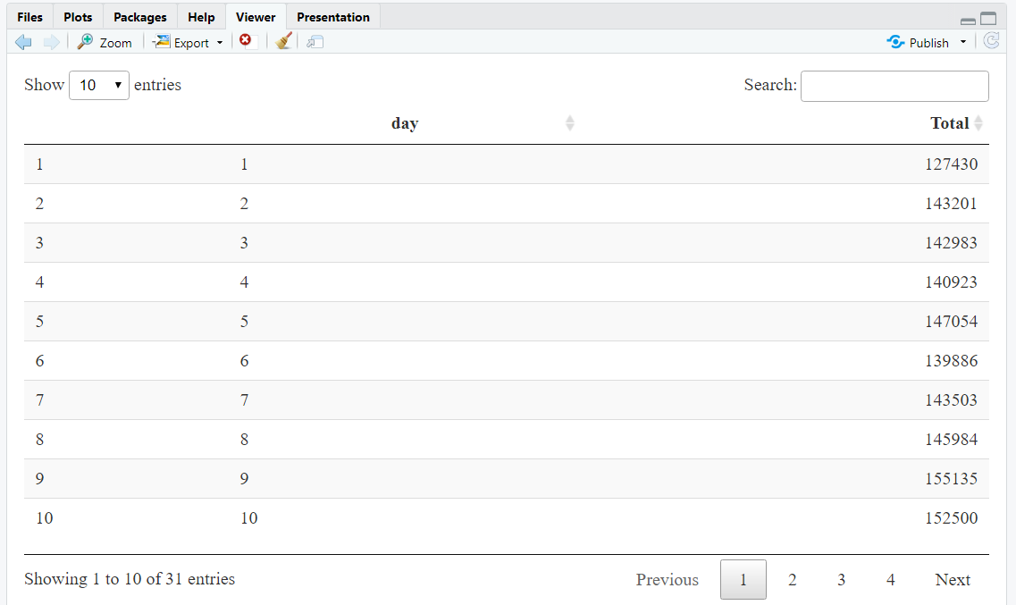
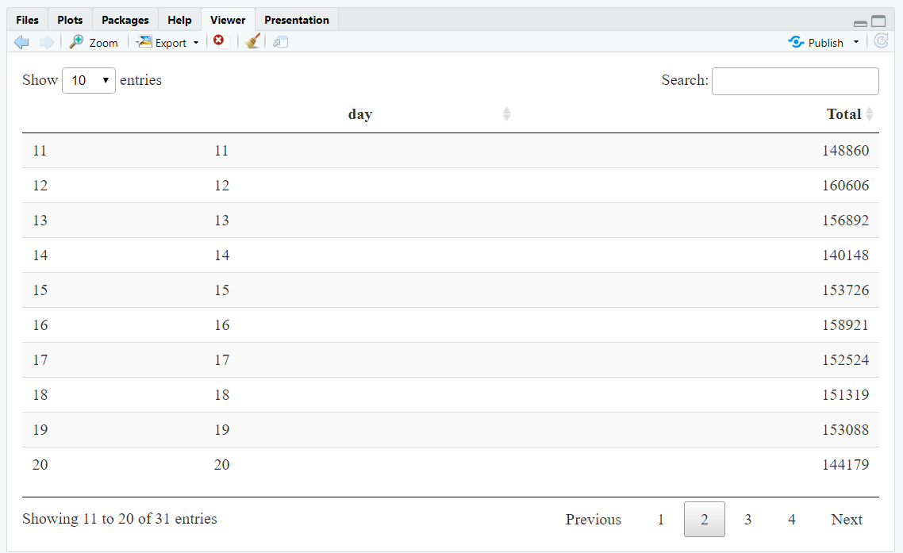
Plotting data by trips during every day of the month
Here, we will be plotting our data based on every day of the month. We observe from the resulting visualization that 30th of the month had the highest trips in the year which is mostly contributed by the month of April.

Slide 18
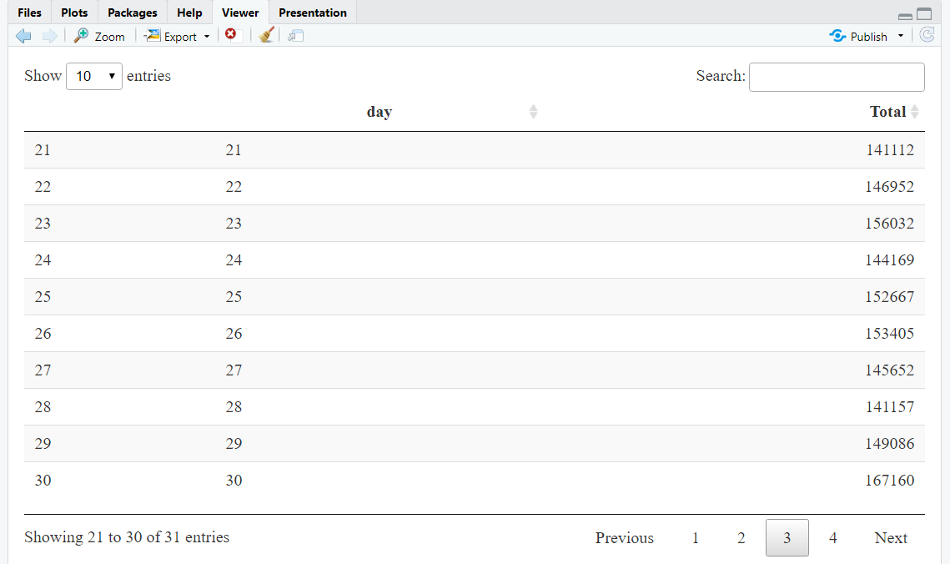
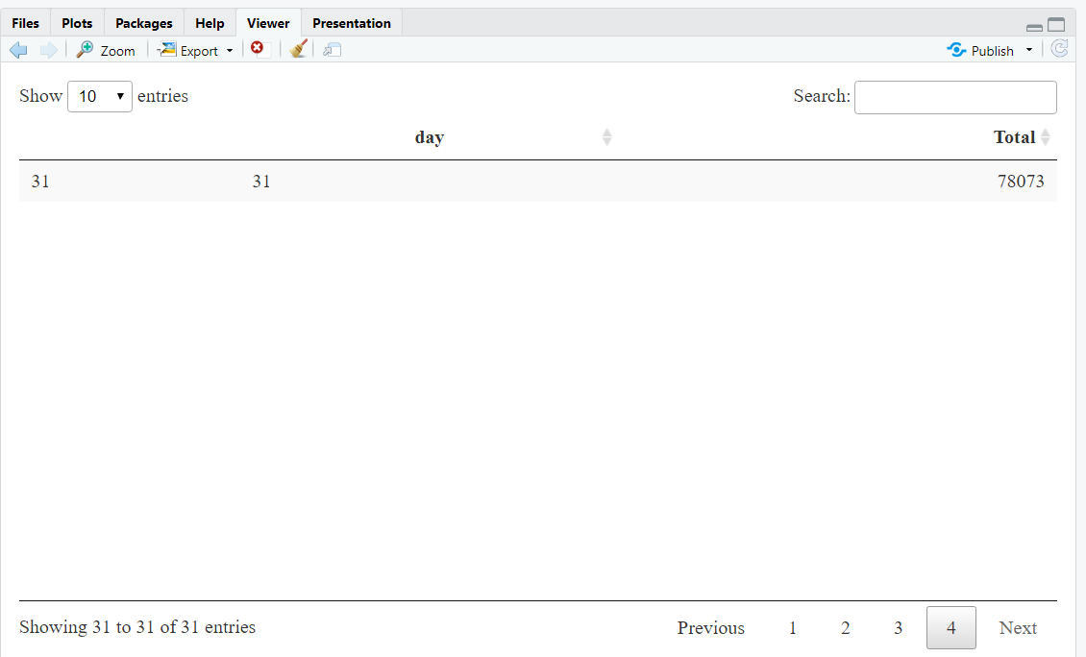

Slide 19
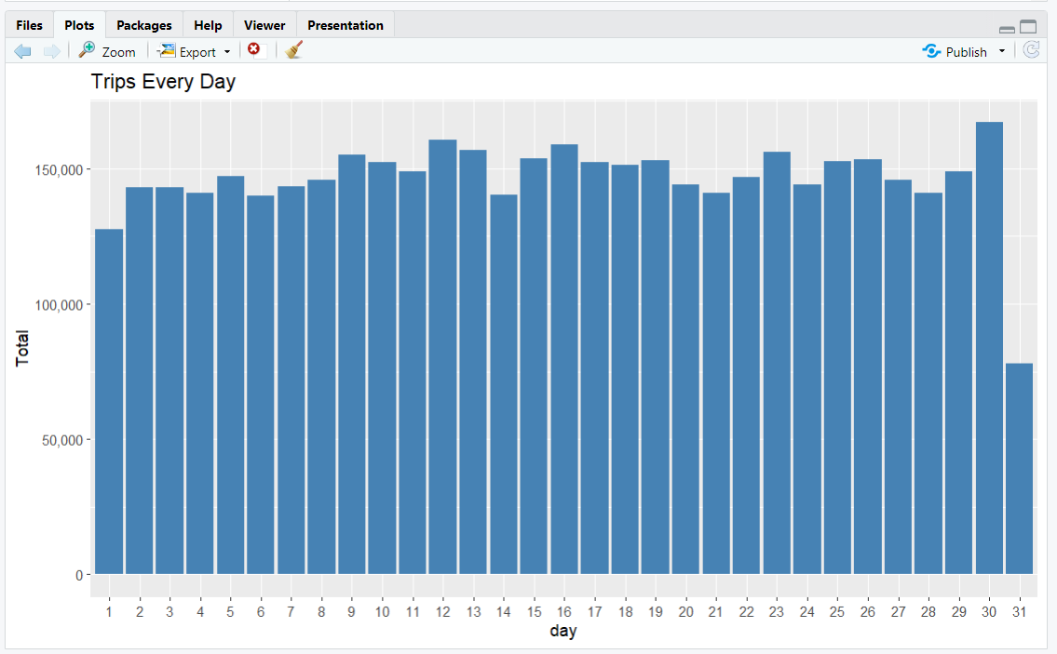
Trips Every Day

Slide 20
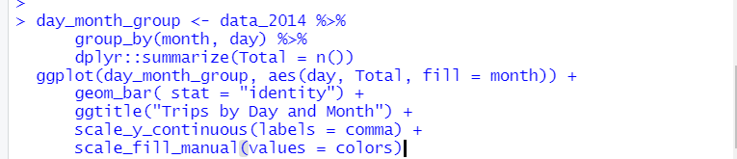
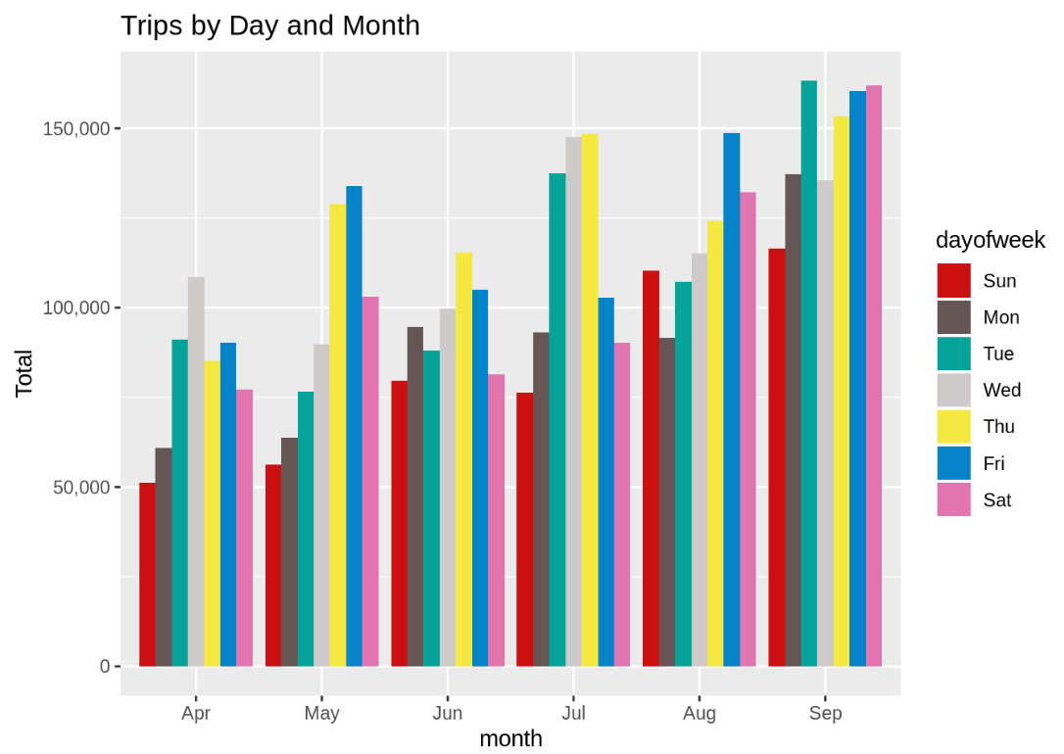
Trips by Day and Month:

Slide 21
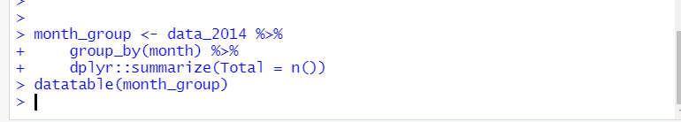
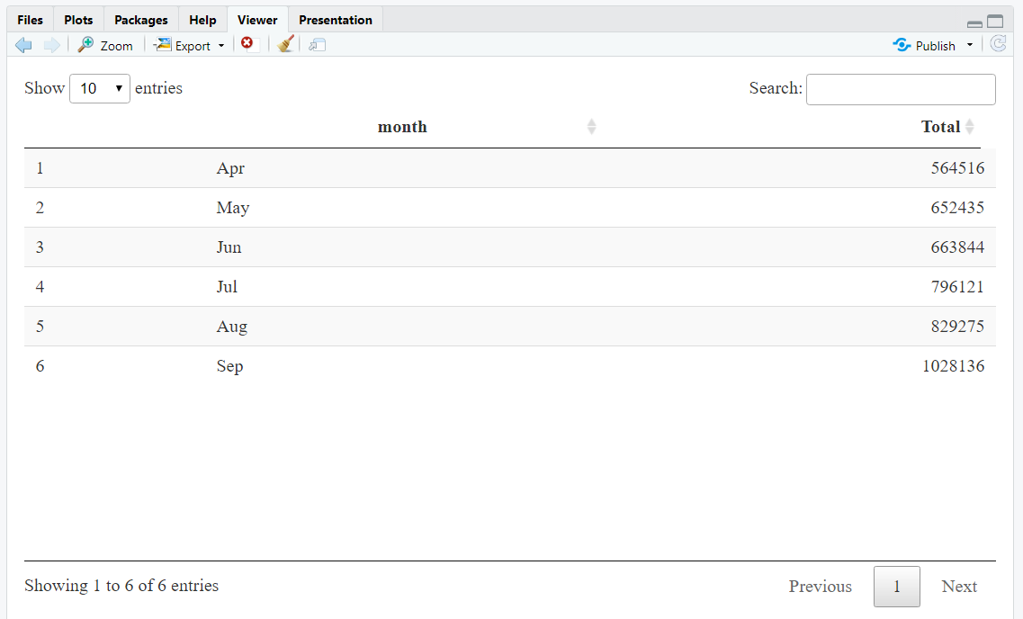
Number of Trips taking place during months in a year
Here, we will visualize the number of trips that are taking place each month of the year.
In the output visualization, we observe that most trips were made during the month of September.
Furthermore, we also obtain visual reports of the number of trips that were made on every day of the week.

Slide 22
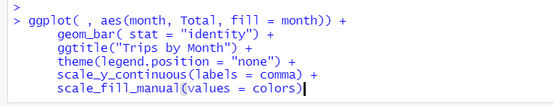
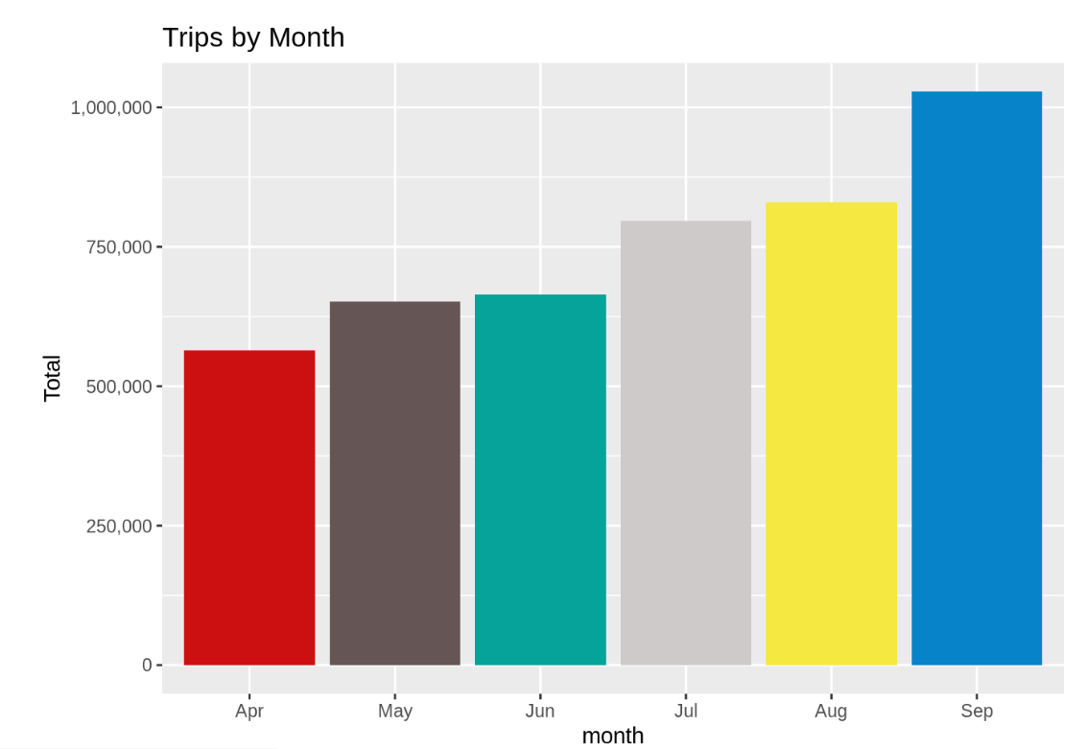

Slide 23
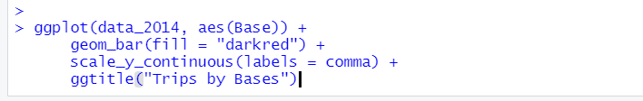
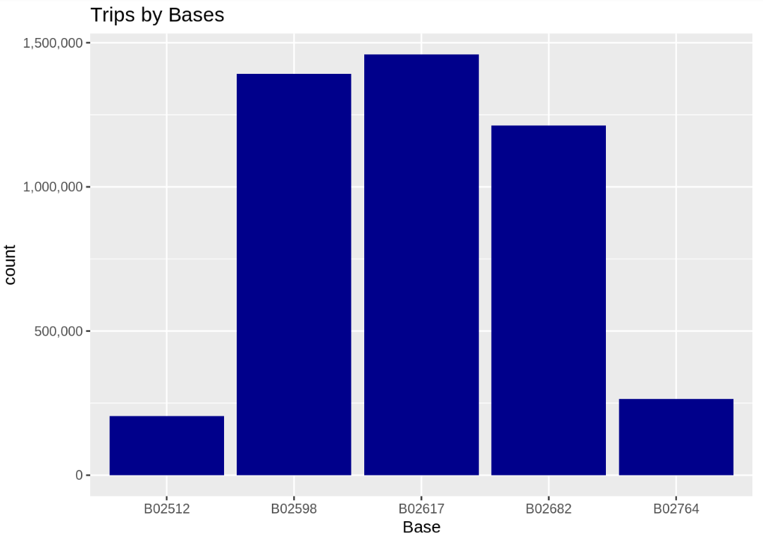
Finding out the number of Trips by bases
In the following visualization, we plot the number of trips that have been taken by the passengers from each of the bases. There are five bases in all out of which, we observe that B02617 had the highest number of trips. Furthermore, this base had the highest number of trips in the month B02617. Thursday observed highest trips in the three bases – B02598, B02617, B02682.

Slide 24
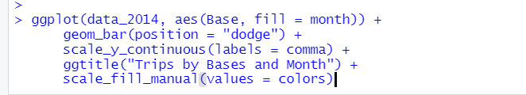
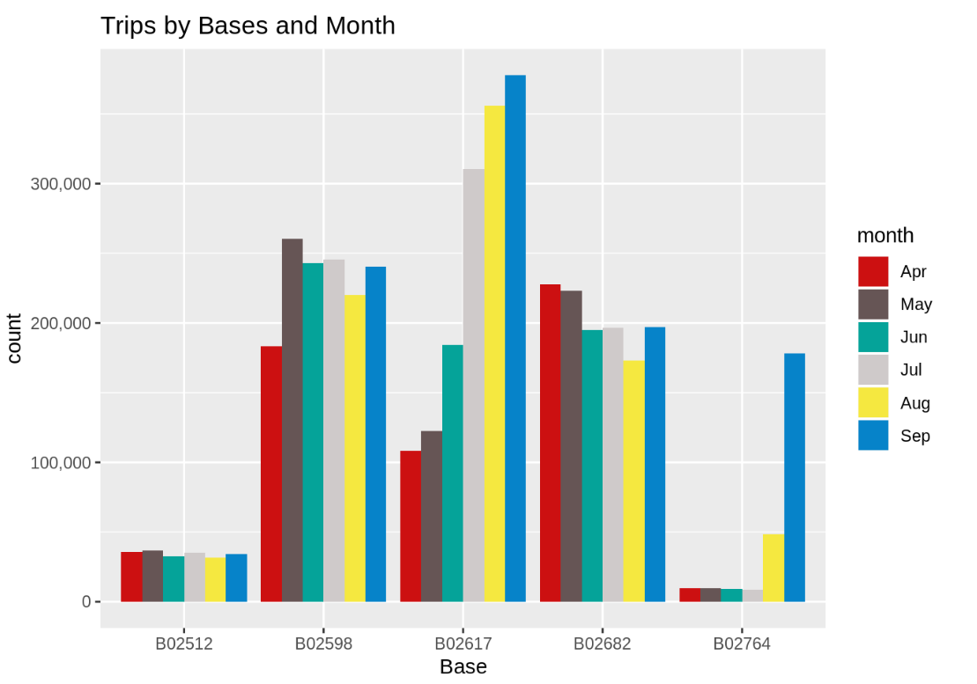
Trips By Bases and Months:

Slide 25
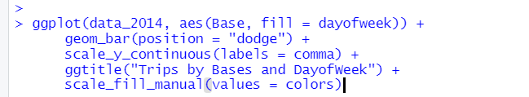
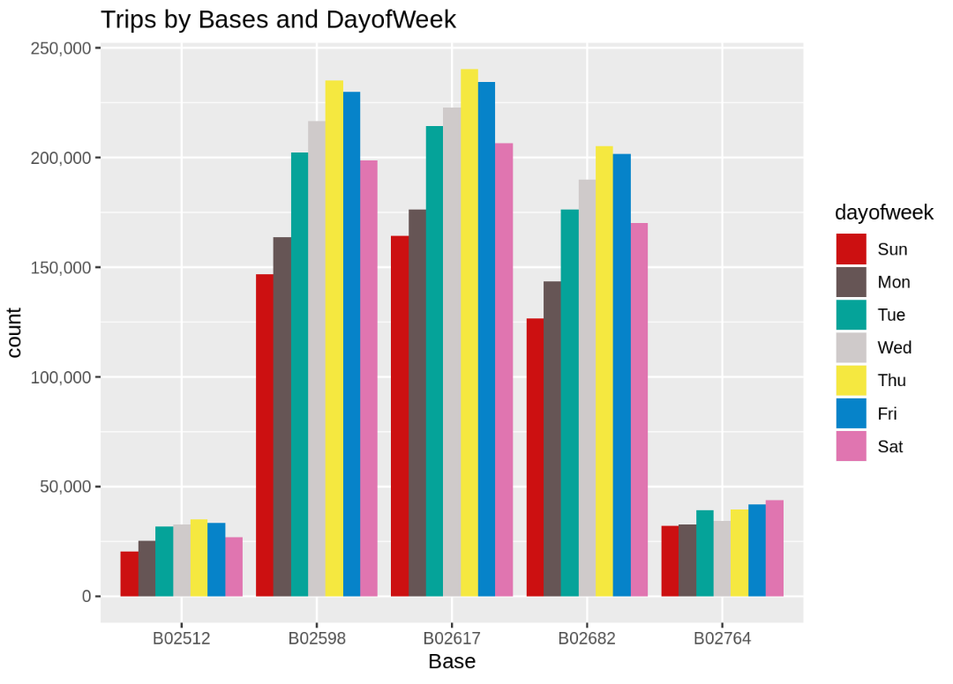
Trips By bases and Day of week:

Slide 26
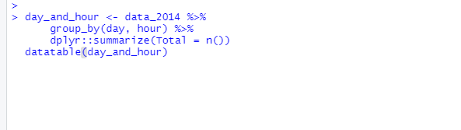
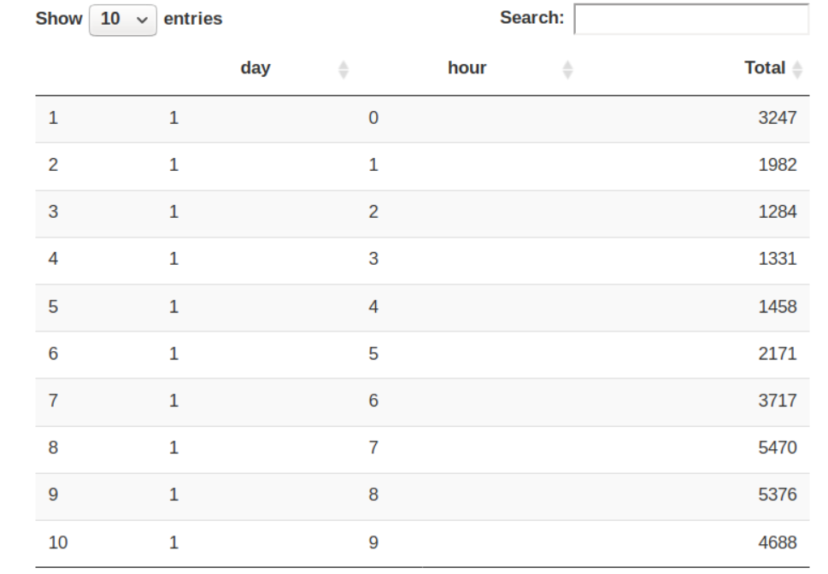
Creating a Heatmap visualization of day, hour and month

Slide 27
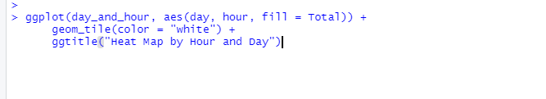

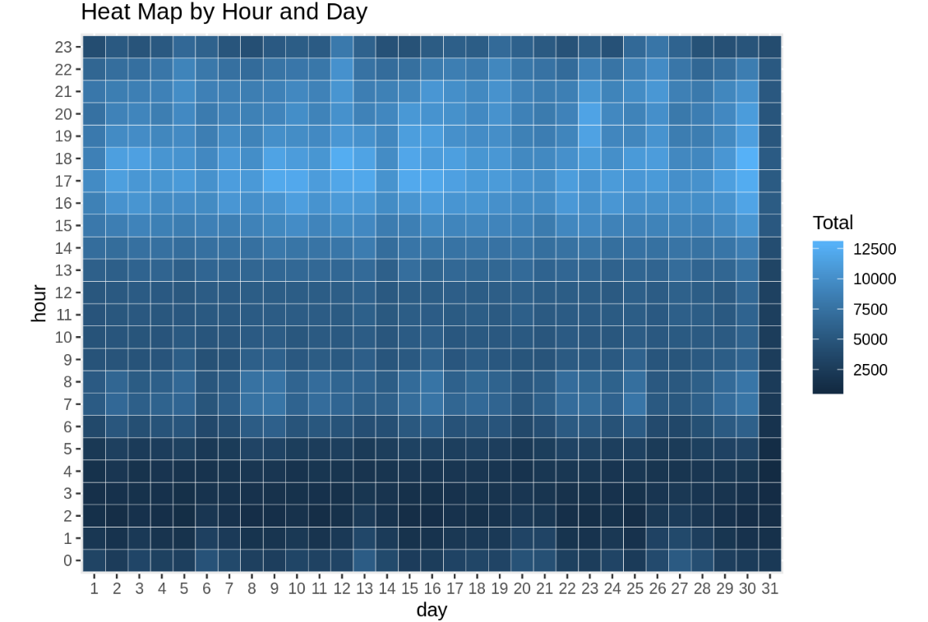
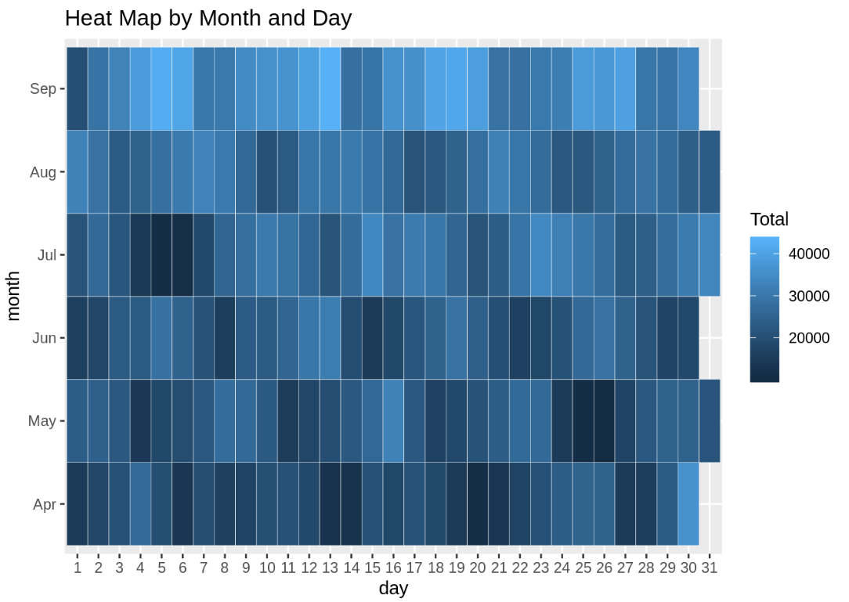

Slide 28

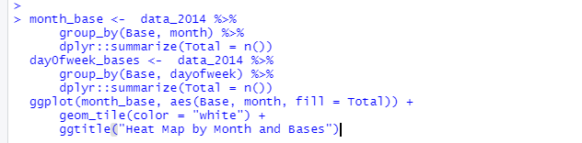
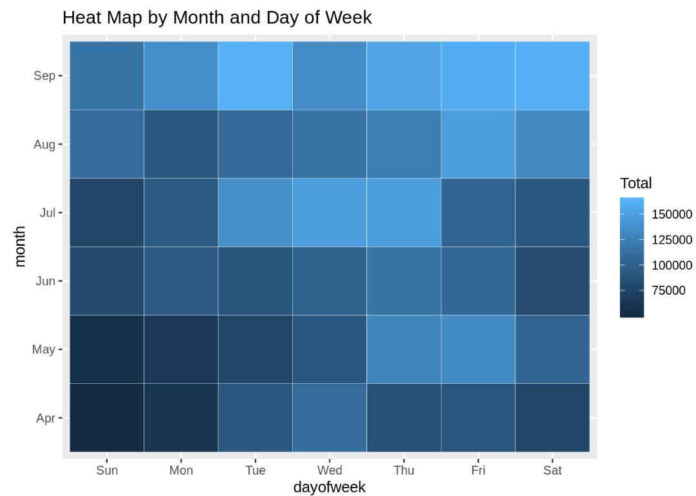
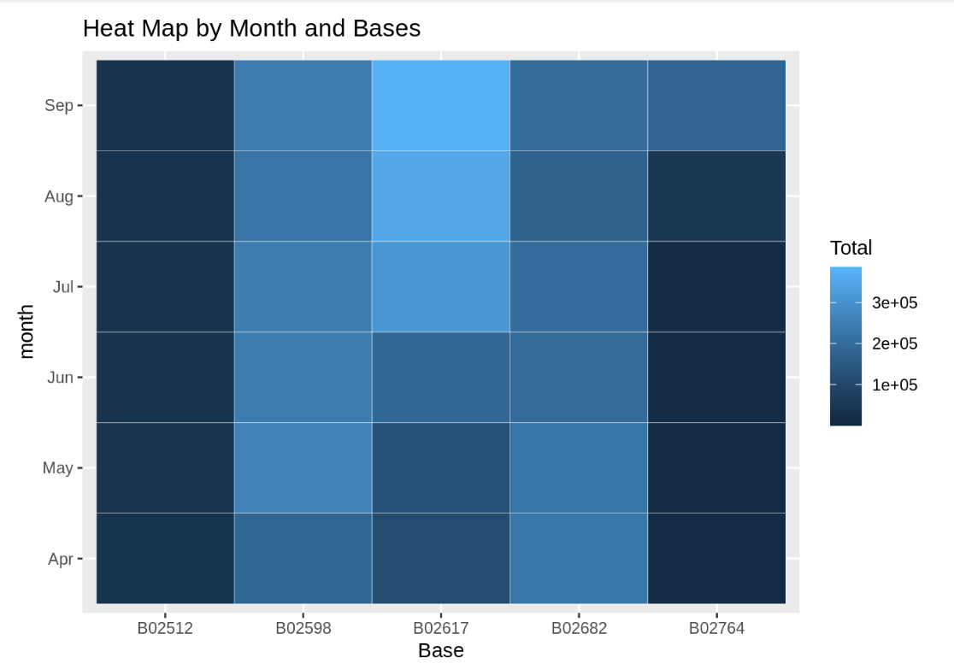

Slide 29

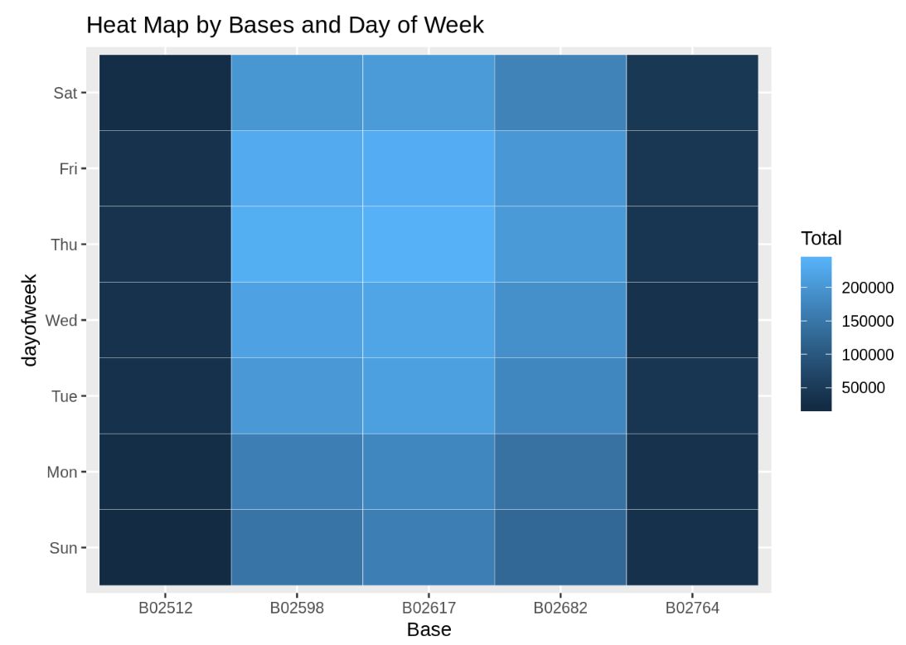

Slide 30
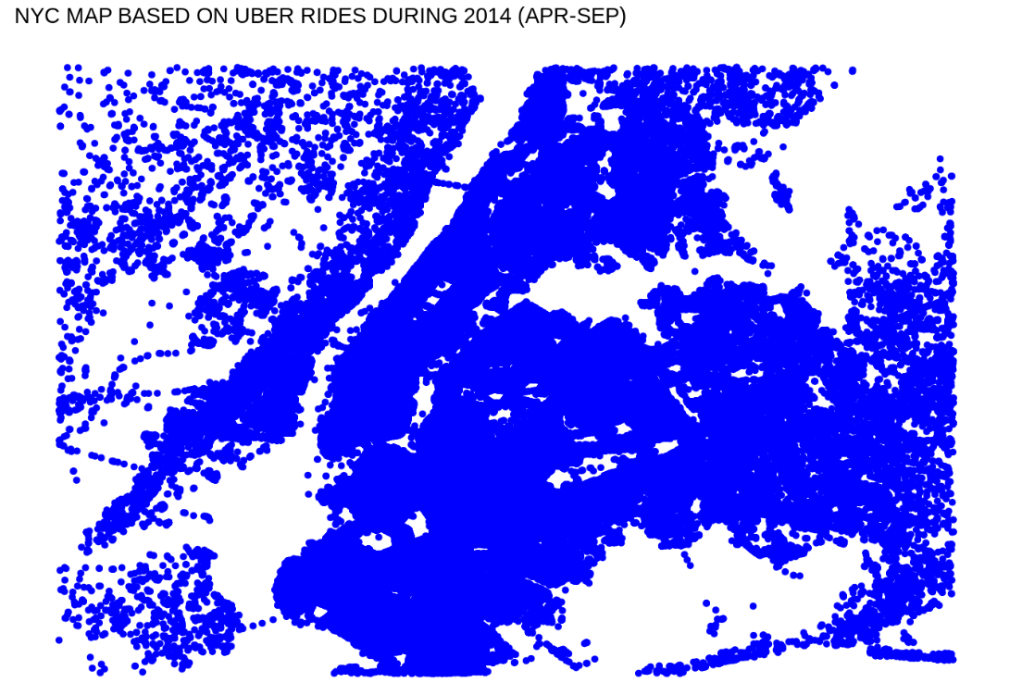
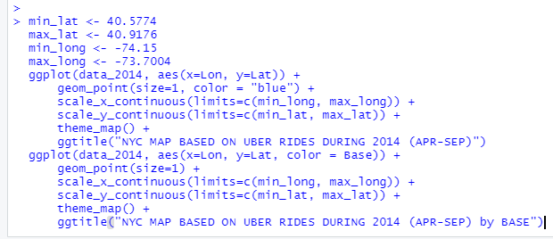
Creating a map visualization of rides in New York
In the final section, we will visualize the rides in New York city by creating a geo-plot that will help us to visualize the rides during 2014 (Apr – Sep) and by the bases in the same period.

Slide 31
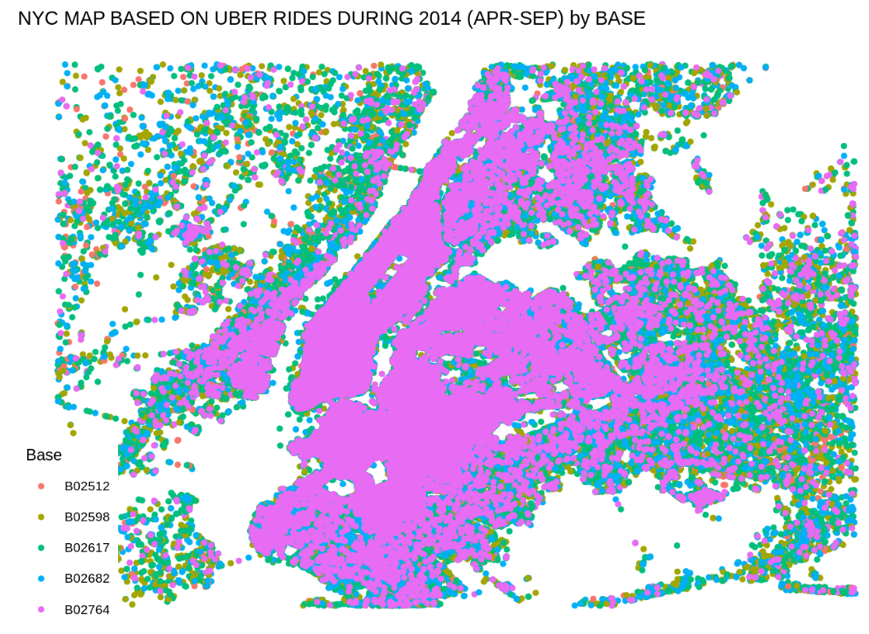
At the end of the Uber data analysis R project, we observed how to create data visualizations. We made use of packages like ggplot2 that allowed us to plot various types of visualizations that pertained to several time-frames of the year.
With this, we could conclude how time affected customer trips. Finally, we made a geo plot of New York that provided us with the details of how various users made trips from different bases.

Slide 32
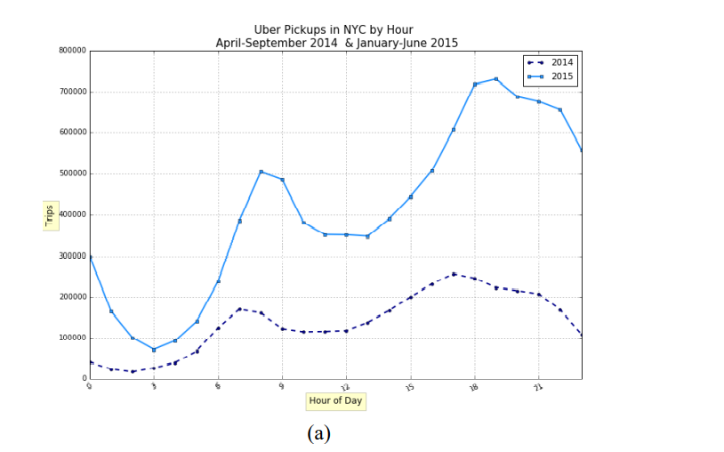
Comparing with the next year:
From 2014 to 2015, Uber trips increased dramatically by 10 million (223.3%), while taxi trips (include both yellow and green taxis) decreased slightly by 0.8 million (1.0%).

Slide 33
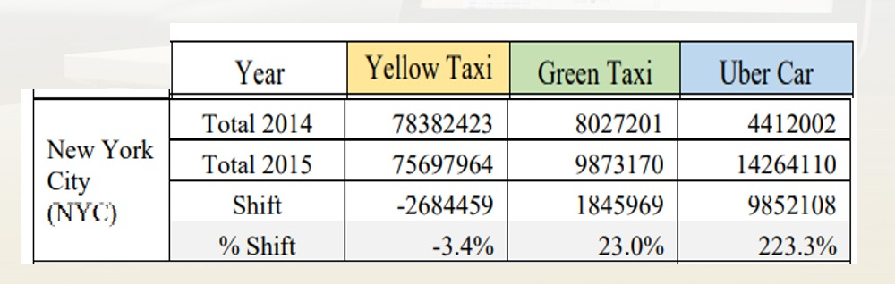

Slide 34
Summary:
Toward the finish of the Uber data analysis R project, we saw how to make Data visualizations. We utilized packages like ggplot2 that permitted us to plot different kinds of representations that related to a few time periods of the year. With this, we could finish up what time meant for client trips. At last, we made a geo plot of New York City that gave us the brief idea of how different clients made trips from various bases.
Conclusion:
At the end of this Uber data analysis R project, we studied how to create data visualizations. We used package ggplot2 that helped us to plot various types of visualizations that pertained to several time-frames of the year. With this, we conclude how time and place affected customer trips.

Slide 35
Finally, we made visualization a Geo plot of New York that provided us with the details of how various users made trips from different bases.
Future Scope:
We can use this data for training a model using ML and building a smart AI based predictive system. Model can automatically send the insights to the authorities or drivers related to areas having most trips and passenger count in certain areas. This big data can be used to study passenger’s behaviour.

Slide 36


